Slide 1
Glycogen & Calcium Metabolism
DR. ARNEL BANAGA SALGADO, Psy.D., FMP (Psychology), Ed.D., Sc.D., RN, PGD
H/P No.: 050-799-3803
URL: www.ifeet.org; www.arnelsalgado.com
Member: Sigma Theta Tau International – Honor Society of Nursing (Constituent No. 1628977)
Member: American Psychological Association (APA Roll No. 04438162)
Doctor of Psychology (Psy.D.)
Ph.D. Psychology
Doctor of Science (D.Sc.)
Doctor of Education (Ed.D.)
Master of Arts in Nursing (M.A.N)
Master of Arts in Teaching - Psychology (M.A.T.)
Registered Nurse (PH, MYL, UAE)
Licensed Teacher (PH)
Certificate in Teaching,
Bachelor of Science in Nursing (BSN, PH)

Slide 2
Glycogen Mobilization: Glycogenolysis
Glycogenolysis is a catabolic process; the breakdown of glycogen to glucose units.
Glycogen is principally stored in the cytosol granules of -
Liver
Muscle

Slide 3
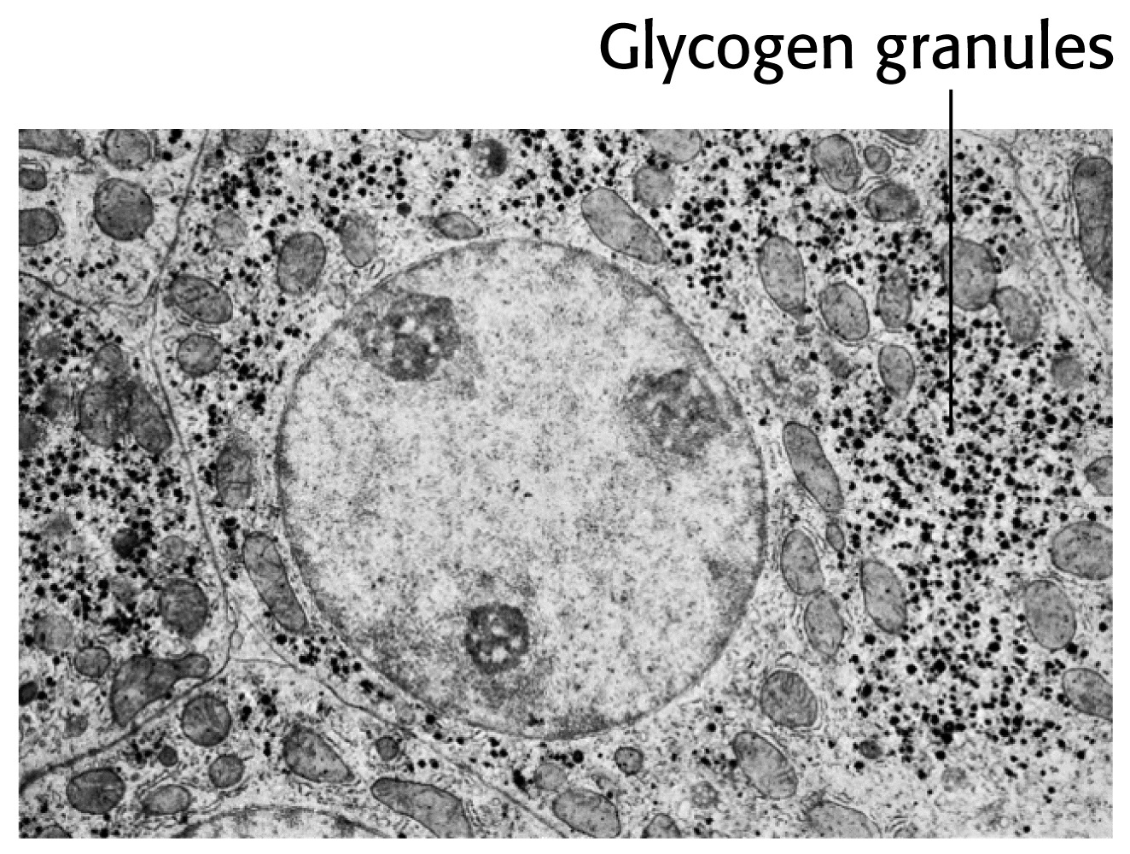
Liver Cell

Slide 4
Glycogen Function
In liver – The synthesis and breakdown of glycogen is regulated to maintain blood glucose levels.
In muscle - The synthesis and breakdown of glycogen is regulated to meet the energy requirements of the muscle cell.

Slide 5
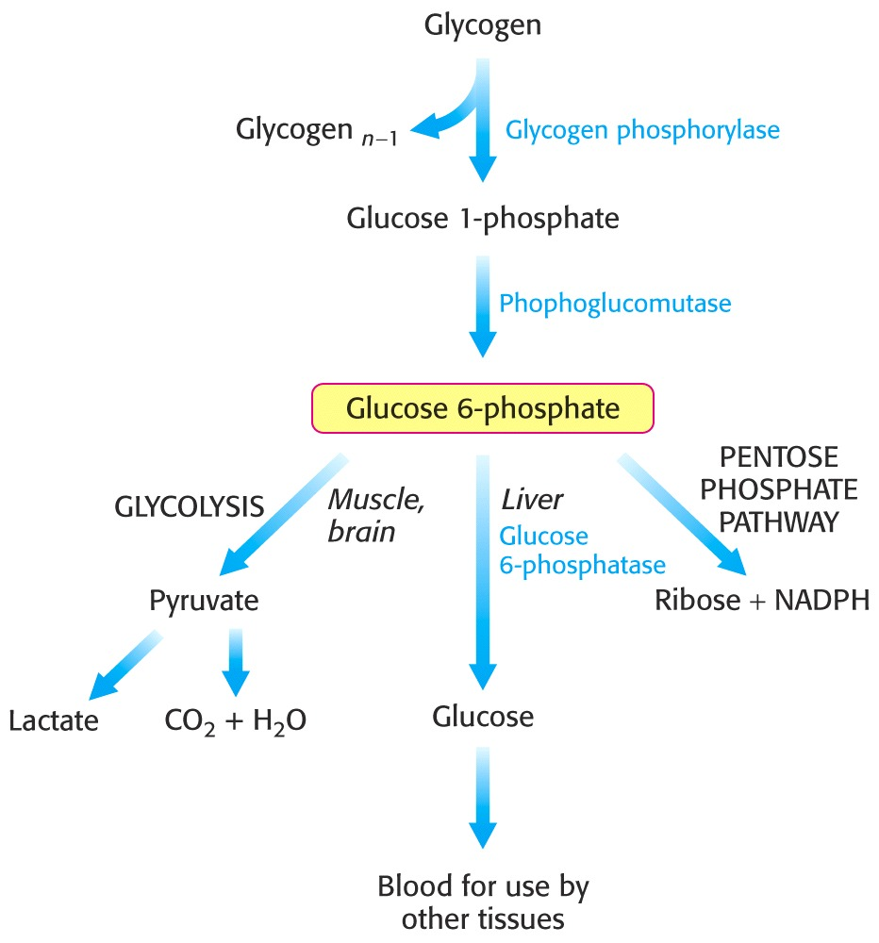
Glucose 6-phosphate has 3 fates.

Slide 6
The α-1,4-linkage predominates.
Synthesis requires the addition of glucose to the non-reducing ends of glycogen via UDP-glucose.

Slide 7
Glycogen phosphorylase catalyzes the breakdown of glycogen.
Glycogen + Pi  Glucose 1- phosphate + glycogen
(n residues) (n-1 residues)

Slide 8
A note on the energetics.
The reaction is reversible
It proceeds to the right (breakdown) because [P_{i}]/[glucose 1-phosphate ratio > 100.
Notice the release sugar is already phosphorylated. No investment of ATP is required and can enter glycolysis directly.
The phosphorylated product (glucose 1-phosphate) can not leave the cell.

Slide 9
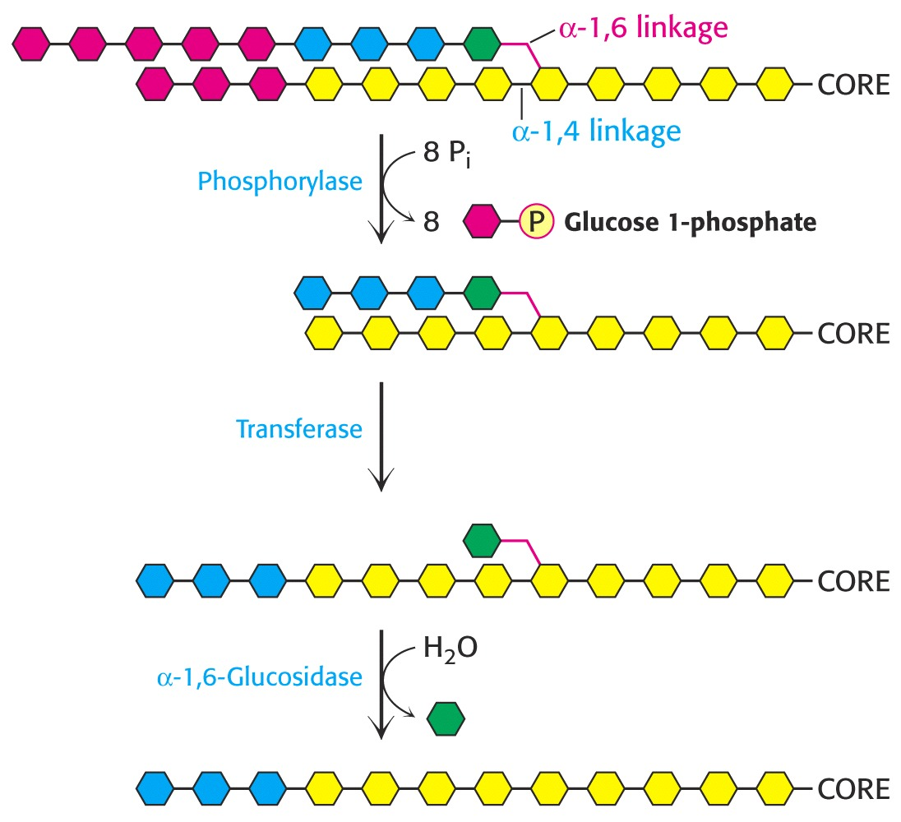
Phosphorylase is specific for the α-1,4 linkage. Two additional enzymes are required.
Linear molecule is created.
Shifts 3 glycosyl units to the core.
Hydrolyzes the single 1,6 glucose unit to free glucose.
Hexokinase →glu.6-P

Slide 10
Note!
In eukaryotes the transferase activity and the α-1,6-glucosidase activity are within one bifunctional protein.
The glucose 1-phosphate to converted to glucose 6-phosphate by phosphoglucomutase.

Slide 11
Glucose 6-phosphate has 3 fates.

Slide 12
Remember!
Liver contains glucose 6-phosphatase.
Muscle does not have this enzyme.
WHY?
The liver releases glucose to the blood to be taken up by brain and active muscle. The liver regulates blood glucose levels.
The muscle retains glucose 6-phosphate to be use for energy. Phosphorylated glucose is not transported out of muscle cells.

Slide 13
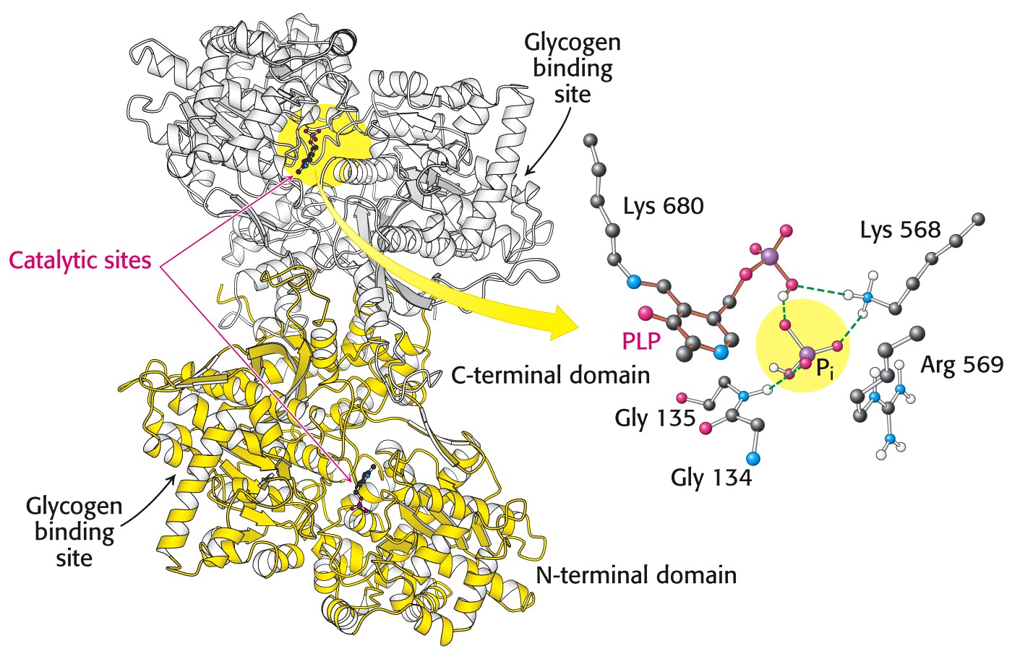
Pyridoxal phosphate is the coenzyme for phosphorylase.
The active site is hydrophobic.
Phosphorylation of glucose without ATP.

Slide 14
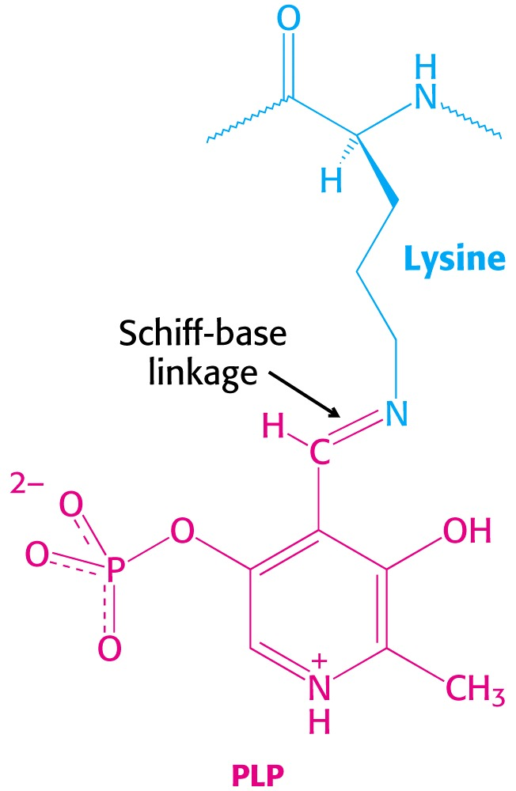
Glycogen phosphorylase uses pyridoxal phosphate (PLP) a derivative of pyridixine (vitamine B₆) as a coenzyme.
B₆ is required for the mobilization of glucose from glycogen. It is also required for other biochemical reactions such as transamination.

Slide 15
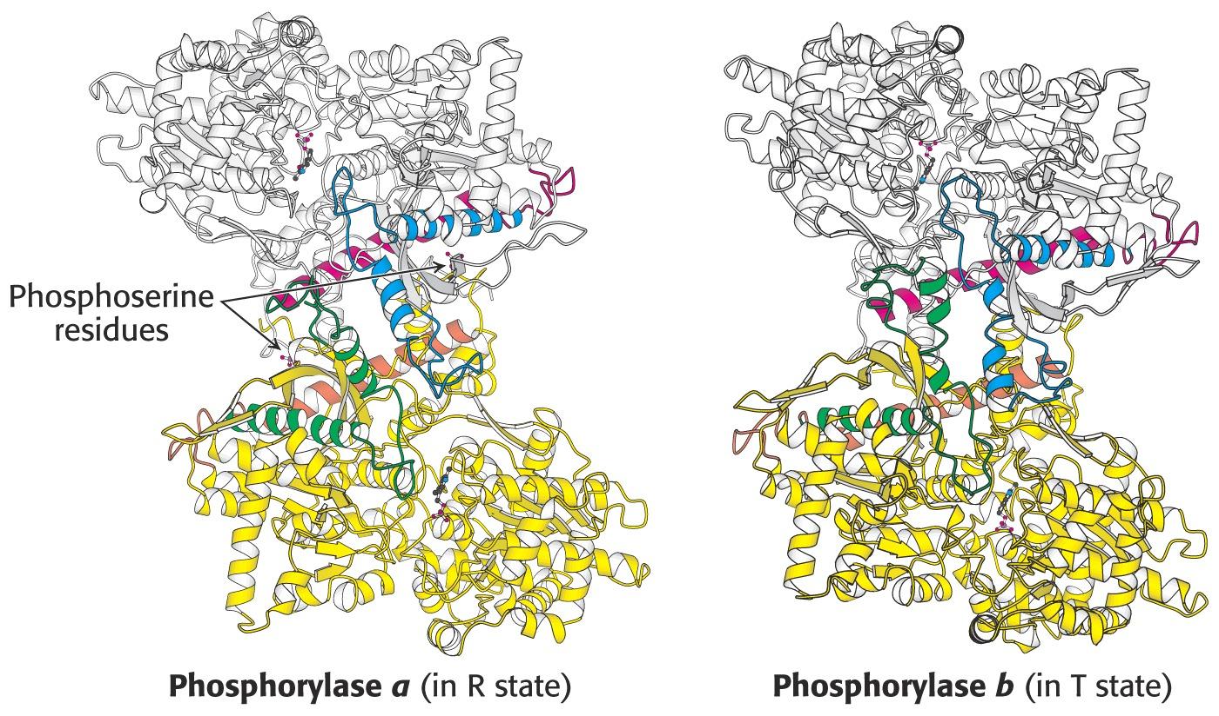
Phosphorylase is an allosteric enzyme.
Active
Inactive

Slide 16
Each of the two forms are in equilibrium between an active relaxed (R) state and less active (T) state.
The equilibrium for phosphorylase a favors the R state (active).
The equilibrium for phosphorylase b favors the T state (less active).
Phosphorylase b is converted to Phosphorylase a (active) with the phosphorylation of serine 14 by the enzyme phosphorylase kinase.

Slide 17
The Bottom Line
Phosphorylase kinase converts phosphorylase b inactive to phosphorylase a active.
The T state is less active because the active site is partially blocked.
The R state is active because the active site is exposed.

Slide 18
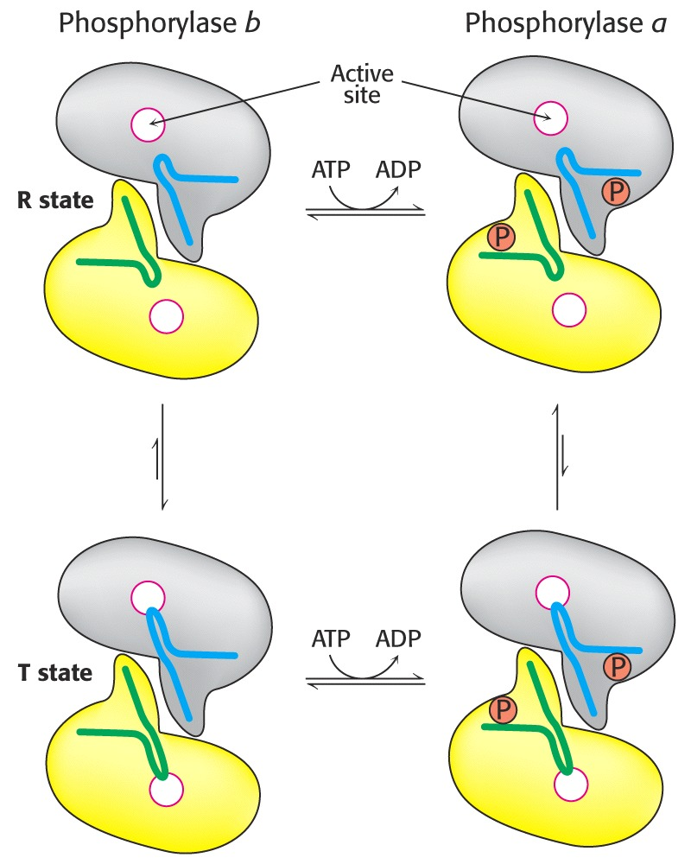
Each of the two forms are in equilibrium between an active relaxed (R) state and less active (T) state.
The equilibrium for phosphorylase a favors the R state.
The equilibrium for phosphorylase b favors the T state.
Muscle

Slide 19
In Muscle
High [AMP] shifts the equilibrium to the active R state.
The muscle cell has a low energy charge.
High [ATP] and [glucose 6-phosphate] shifts the equilibrium to the less active T state.
So the energy charge in muscle cells regulates the transition between T and R states for phosphorylase b.

Slide 20
In Muscle
Phosphorylase b predominates.
In resting muscle phosphorylase b is in the inactive T state.
With exercise the increase [AMP] shifts the equilibrium to the active R state.
Exercise will also stimulate the hormone epinephrine which will convert phosphorylase b to phosphorylase a.

Slide 21
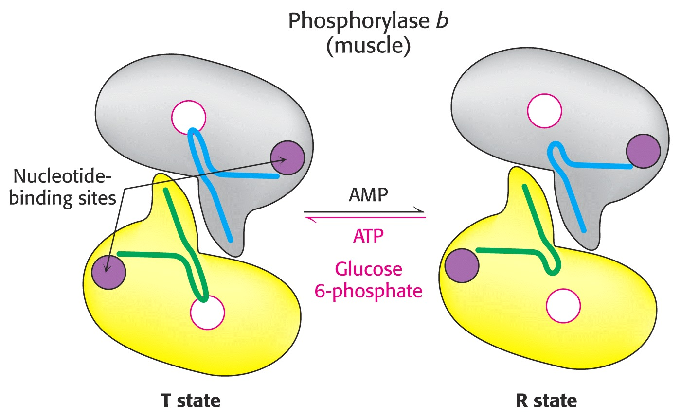

Slide 22
In Liver - A different story
Glucose shifts the phosphorylase to the T state, deactivating the enzyme.
Glucose is a negative regulator of liver Phosphorylase.
Glucose is not mobilized when glucose is abundant.
Liver phosphorylase is insensitive to AMP.
Liver does not exhibit dramatic changes in energy charge as in contracting muscle.

Slide 23
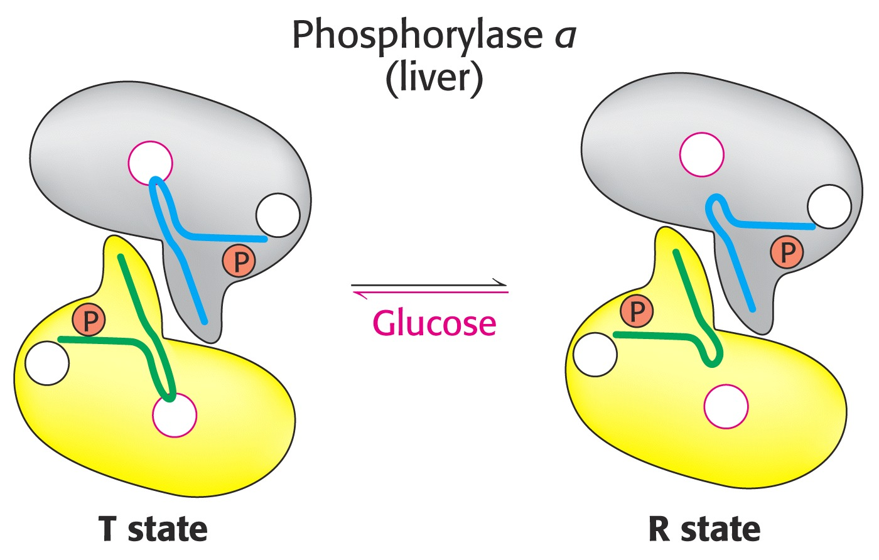
Liver slightly different aa sequence than muscle

Slide 24
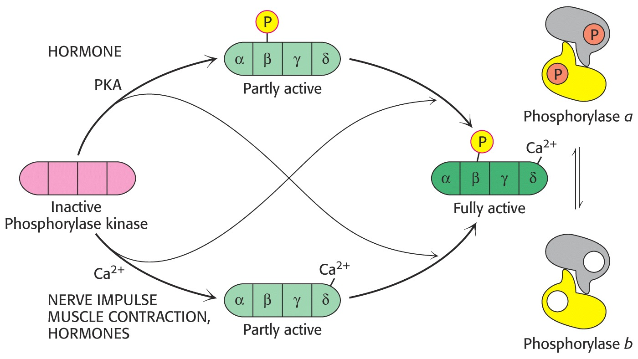
Fully active phosphorylase kinase requires Ca⁺⁺ and a phosphate.
protein
kinase A

Slide 25
Epinephrine and Glucagon Stimulate Glycogen breakdown
Muscle is responsive to epinephrine.
Liver is responsive to glucagon and somewhat responsive to epinephrine.
Both signal a cascade of molecular events leading to glycogen breakdown.
Both utilize a G-protein-dependent signal-transduction pathway.

Slide 26
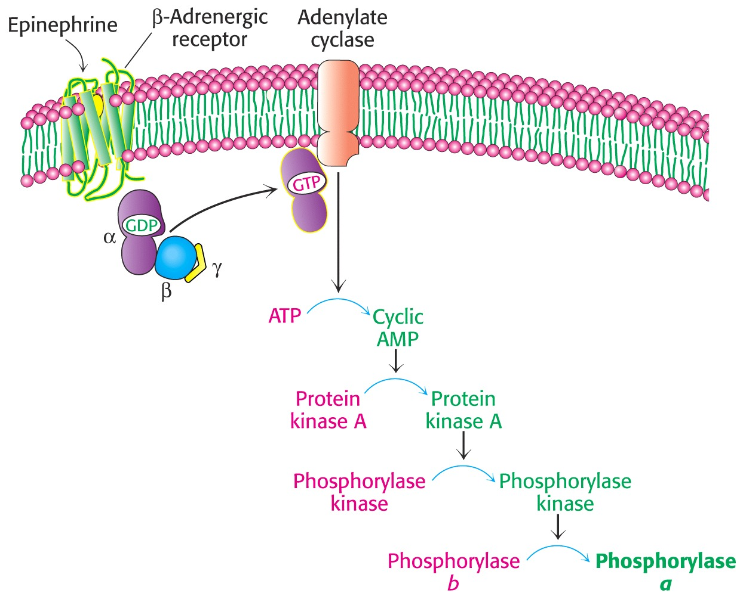
A few hormone molecules cause the release of large amounts of glucose, a cascade.

Slide 27
Glycogenesis The Synthesis of Glycogen An Energy Consuming Pathway

Slide 28
Glycogenesis
Glycogen is synthesized via uridine diphosphate glucose (UDP – glucose).
Synthesis: Glycogen_{n} + UDP-glucose →
glucogen_{n+1} + UDP.
Degradation: glucogen_{n} + P_{i} → Glycogen_{n-1} + glucose 1-phosphate.
Glycogen synthesis and degradation utilize separate pathways.

Slide 29
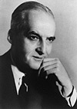
Luis Leloir
Nobel Prize in Chemistry, 1970
“ for his discovery of sugar nucleotides and their role in the biosynthesis of carbohydrates”

Slide 30
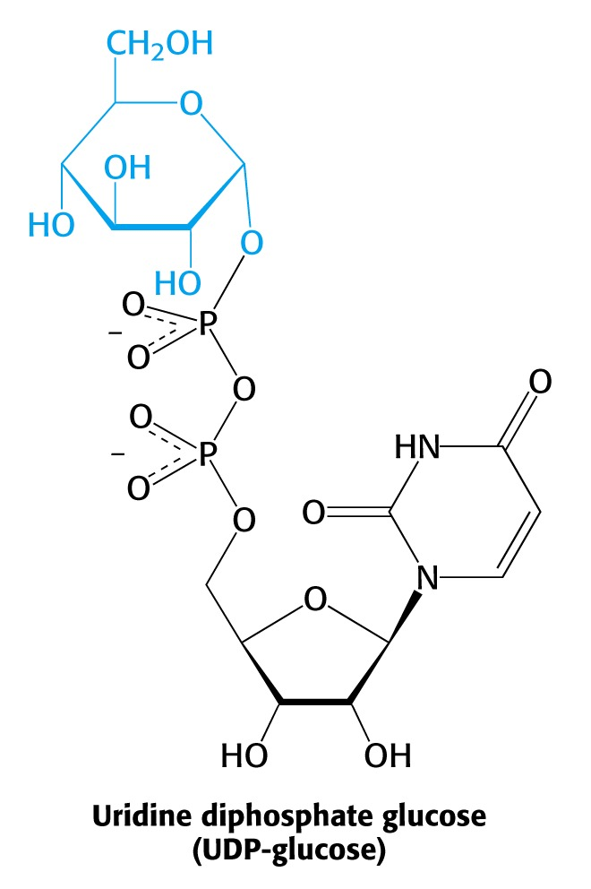
UDP glucose is the activated form of glucose.
Acetyl CoA is the activated form of acetate.
AA-tRNA is the activated form of amino acids.

Slide 31
UDP-glucose pyrophosphorylase
Glucose 1-phosphate + UTP  UDP-glucose + PP_{i}.
pp_{i} + H₂O → 2P_{i}.
Glucose 1-phosphate + UTP + H₂O → UDP-glucose + 2P_{i}.
Although the reaction is reversible the hydrolysis of the pyrophosphate pushes it to the right.

Slide 32
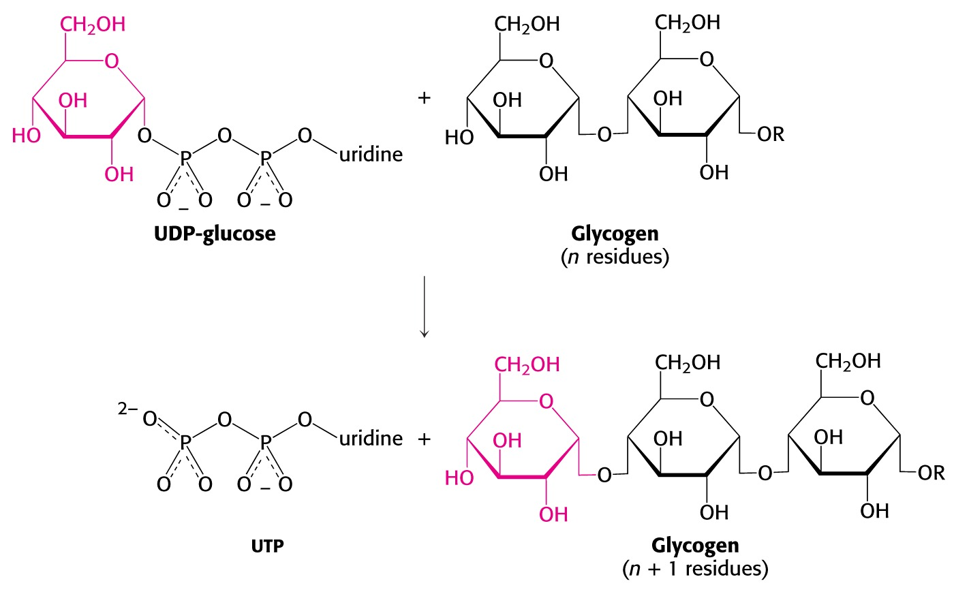
Glycogen synthase catalyzes α-1,4 linkages
A primer of a least 4 units are required via glycogenin.
Glucose is added to the non-reducing end.
UDP

Slide 33
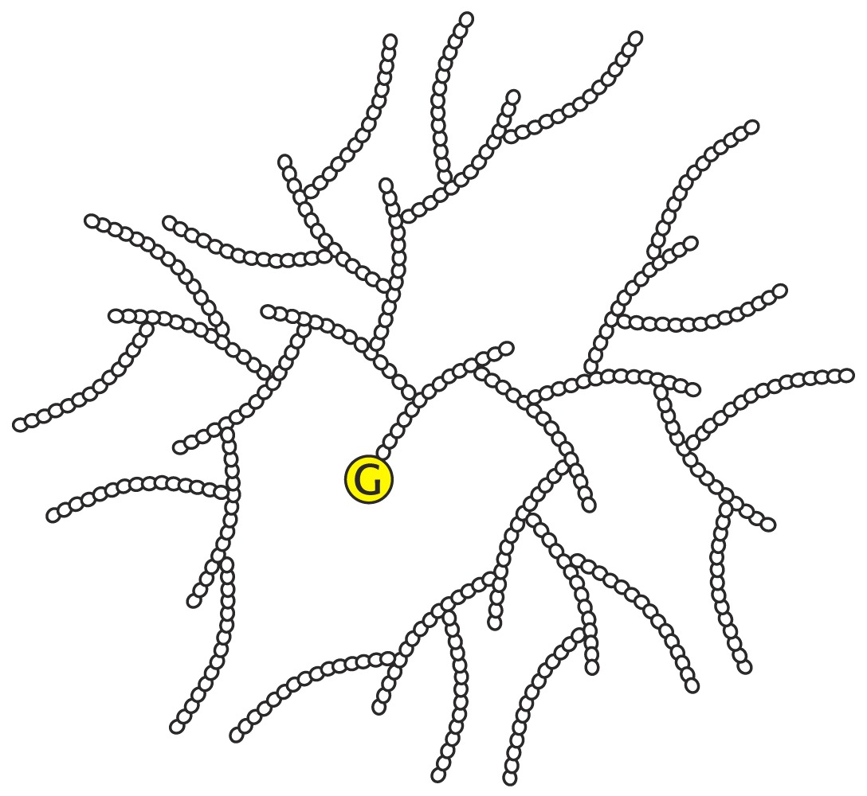
Branching enzyme forms α-1,6 linkages:
Remodeling
The enzyme breaks the α-1,4 link and forms a α-1,6 link. A large number of terminal residues are now available for glycogen phosphorylase; degradation.
Branching increases the solubility of glycogen.

Slide 34
Glycogen synthase is the regulatory enzyme in the synthesis of glycogen.
The enzyme is regulated by covalent modification; phosphorylation.

Slide 35
Regulation of Glycogen Synthase
When the enzyme is phosphorylated, it is inactivated.
Active “a” form to inactive phosphorylated “b” form.
Notice that phosphorylation has the opposite effect on glycogen phosphorylase; phosphorylation activates.

Slide 36
Glycogen synthesis
Glucose 6-P→ glucose 1-P.
glucose 1-P + UTP→UDP-glucose + PP_{i}.
PP_{i} + H₂O→ 2 P_{i}.
UDP-glucose + glycogen_{n} → glycogen_{n+1.}
UDP + ATP → UTP + ADP.
Glucose 6-P + ATP + glycogen_{n} + H₂O →
glycogen_{n+1} + ADP + 2P_{i}.
Only one ATP is used to store one glucose residue in glycogen.
(nucleoside diphosphokinase)

Slide 37
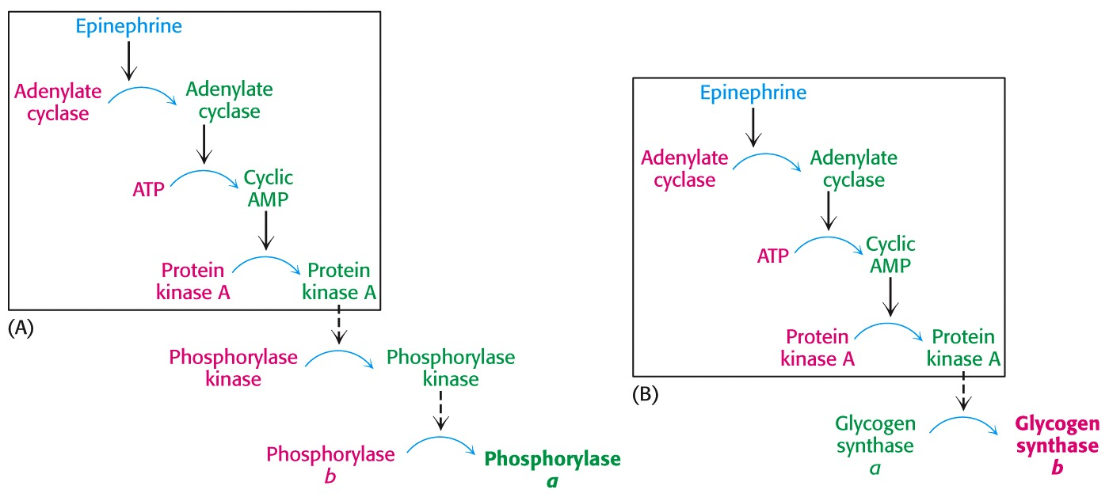
Glycogen synthesis and breakdown are reciprocally regulated
Red=inactive forms, green = active forms.
Active
Inactive
Protein phosphatase 1 (PP1) regulates glycogen metabolism.

Slide 38
Protein Phosphatase 1
PP1 dephosphorylates phosphorylase kinase and phosphorylase a, thus inactivating glycogenolysis.
PP1 also dephosphorylates glycogen synthase b, thus activating glycogen synthesis.

Slide 39
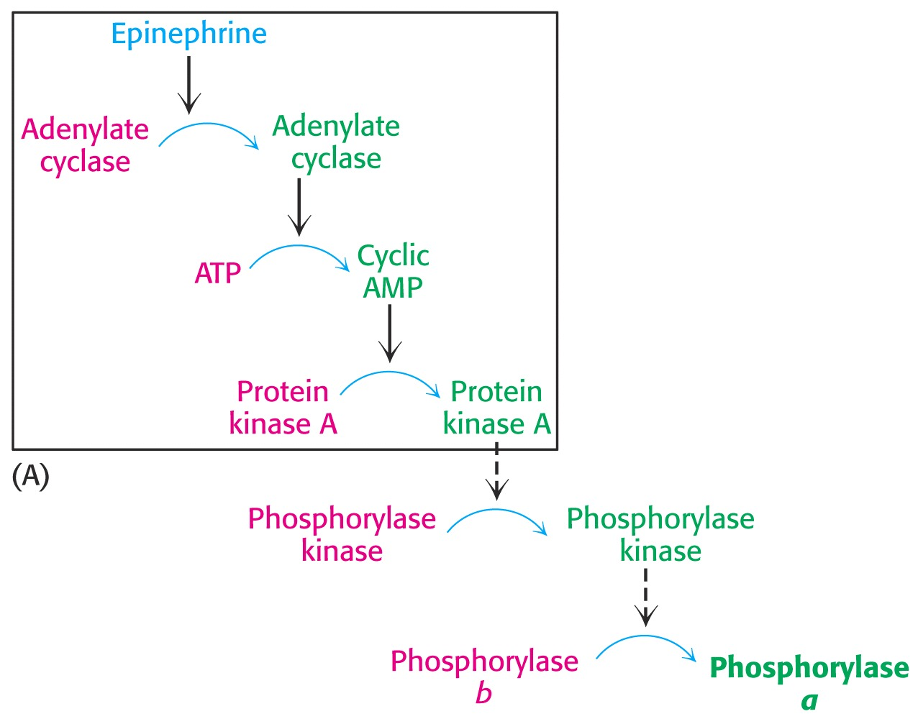
PP1 dephosphorylates phosphorylase kinase and phosphorylase a thus inactivating glycogenolysis.

Slide 40
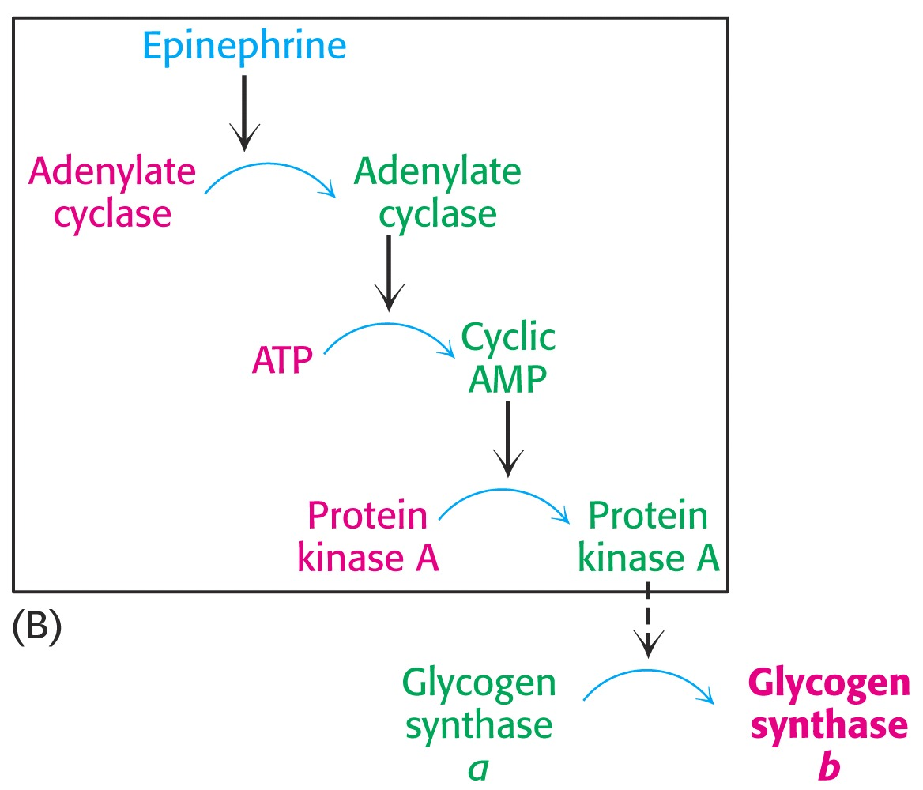
PP1 dephosphorylates glycogen synthase b thus activating glycogen synthesis

Slide 41
When blood glucose levels are high, insulin activates protein phosphatase 1 which stimulates glycogen synthesis.
This is accomplished through a complex highly regulated signal transduction pathway.
Remember: Glycogen metabolism in liver regulates blood glucose levels.

Slide 42
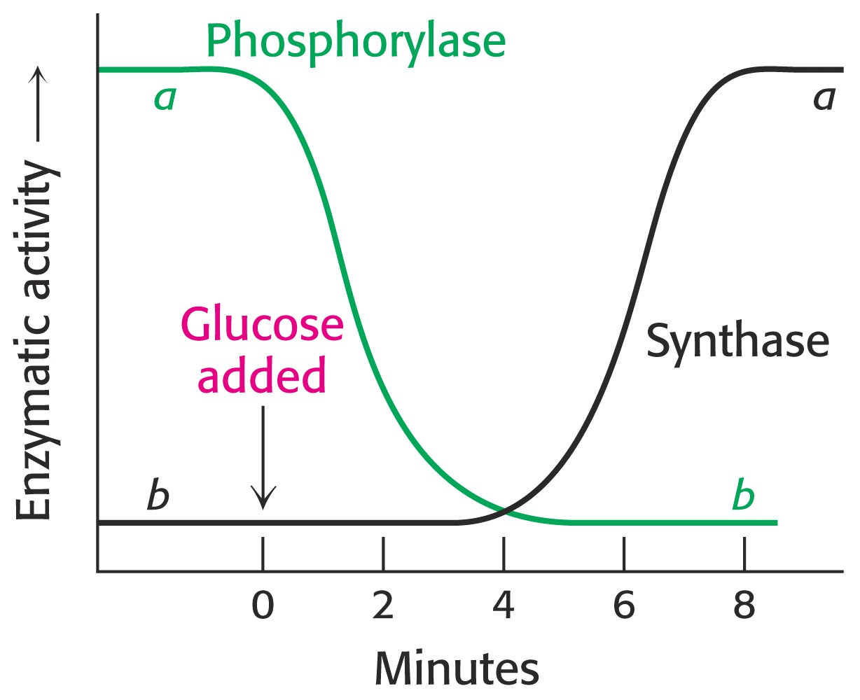
Blood glucose levels rise after ingestion of carbohydrates, leading to glycogen synthesis.
Inactivation of phosphorylase and an activation ofglycogen synthase.
Liver

Slide 43
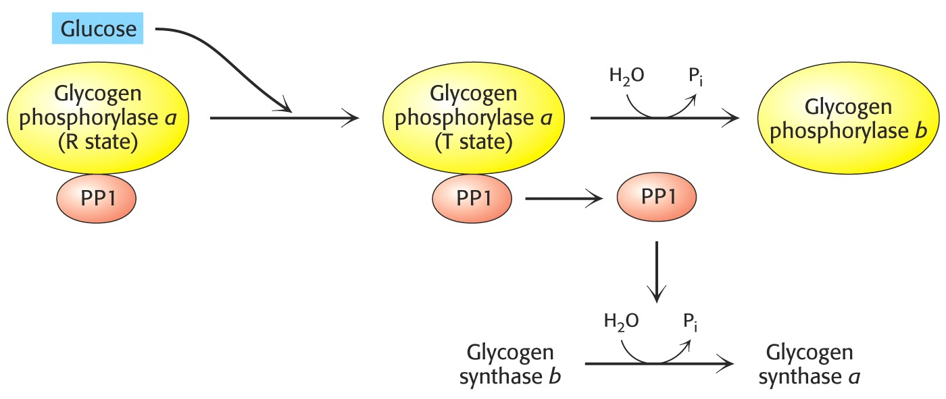
Besides insulin, glucose itself binds to phosphorylase a.
PP1 acts as a catalyst only when phosphorylase a is in the T state.
The conversion of a→b releases PP1 to activate glycogen synthase.
In liver
inhib
inact.
When blood glucose is high.
When PP1 is free.
Muscle phosphorylase a is unaffected by glucose.
act.

Slide 44
A Take Home Lesson!
Glucogon = starved state; stimulates glycogen breakdown, inhibits glycogen synthesis.
High blood glucose levels = fed state; insulin stimulates glycogen synthesis and inhibits glycogen breakdown.

Slide 45
Calcium metabolism

Slide 46
Calcium metabolism
Calcium is an intra-osseous cation (99%).The extra – osseous fraction is only 1% .
The level is essential for normal body function because of the effects on neuromuscular excitability and cardiac muscle.
Hypercalcaemia →→ Muscular hypotonia, cardiac arrest, or arrhythmias.
Hypocalcaemia →→ Tetany and arrhythmias .

Slide 47
Factors affecting calcium intake and loss
Intake
1- The amount of calcium in the diet .
2- Vitamin D .
Loss
1- The amount of calcium reaching the glomeruli.
2- Glomerular filtration rate (GFR) and renal tubular function (CRF→ impaired activation of V.D).
3- PTH and vitamin D .
4- The amount of oxalate, phosphate and FA in the diet form insoluble complexes with calcium.

Slide 48
Concept of plasma calcium and albumin conc.
Plasma calcium level is 2.15-2.55 mmol/l.
It is found in two forms:
1- Less than 1/2 is bound to albumin (inactive).
2- Most of the rest is free ionized calcium (active).
Total plasma calcium is lower in the supine than in the upright position (fluid distribution → protein conc.).

Slide 49
Blood for calcium determination should be taken without tourniquet to avoid stasis, it leads to false increased plasma calcium.
Plasma corrected calcium (mmol/l) = plasma measured calcium + [40-plasma albumin(g/l)] * 0.02

Slide 50
Relationship between hydrogen and calcium ion
In acidosis : Hydrogen ion competes with calcium to bind protein, as well as the increase of the solubility of calcium substances in bone so the free fraction elevates and may cause osteomalacia.
In alkalosis : The protein bound fraction increases and the solubility of calcium substances is low, so the free fraction decreases and may leads to tetany.

Slide 51
Control of plasma calcium
It depends on :
1- An adequate supply of calcium and vitamin D.
2- Normal function of the intestine, parathyroid glands and kidney.

Slide 52
The role of PTH, calcitonin and V.D in calcium metabolism
PTH
Stimulates the osteoclastic bone resorption, so increase the plasma calcium and phosphate levels.
Decreases renal tubular reabsorption of phosphate and increases the calcium reabsorption .

Slide 53
Calcitonin
It is secreted from C-cell of the thyroid gland, decreases osteoclastic activity, opposite PTH action . Moreover, plasma calcium may be very high in medullary carcinoma of the thyroid.
Vitamin D
Increase calcium absorption in the intestine.
In conjunction with PTH, it stimulates the osteoclastic activity.
Thyroid H.
Increases faecal and urinary excretion of calcium.

Slide 54
Hypercalcaemia
Clinical effects of an increase calcium level include renal damage, polyuria, hypokalaemia, hypotonia, depression, constipation and abdominal pain. The causes are :
Malignancy
- Bony metastases such as breast, lung, prostate and kidney.
- Solid tumors with humeral affects.
Hematological tumors such as myeloma.
Drugs
Thiazides (reduced renal calcium excretion) and vitamin A toxicity (activates the osteoclasts)

Slide 55
PTH abnormalities
- Primary hyperparathyroidism (adenoma,hyperplasia)
- Tertiary hyperparathyroidism (autonomous secretion of PTH)
Lithium induced hyperparathyroidism
High pone turnover
Thyrotoxicosis and immobilization such as pagets disease.
High level of V.D
Vit.D toxicity and granulomatous diseases such as sarcoidosis and tuberculosis

Slide 56
Hypocalcaemia
Increases the neuromuscular activity, may leads to tetany or paraesthesiae. It also leads to arrhythmias. The causes are:
Drugs
Furosemide (increases renal excretion), enzyme induced drugs e.g. Phenytoin (induces hepatic enzymes that inactivate Vit.D).
Causes of hypocalcaemia with hypophsphataemia
- Vitamin D deficiency which leads to rickets in children and osteomalcia in adults.
- Malabsorption.

Slide 57
Causes of hypocalcaemia with hyperphsphataemia
- CRF.
- Hyperparathyroidism: surgical removal of parathyroid.
- Pseudohypoparathyroidism (impaired response of kidney and bone to PTH).
Miscellaneous causes of hypocalcaemia (rare)
- Acute pancreatitis.
- Sepsis.
- Sever hypomagnesaemia.

Slide 58
Disorders of bone not usually affecting plasma calcium conc.
Osteoporosis : Reduction of bone mass due to thinning of protein on which calcium is usually deposited, with slight increase in urinary calcium loss . calcium and phosphate levels are normal. Bone specific ALP may be useful.
Pagets disease of bone: Increased bone turnover and remodeling due to increased osteoclastic and osteoplastic function. ALP is very high.
- Reference: Martin A C. Clinical chemistry and metabolic medicine.2006

